Slide 1
Fire Alarm System
Group-8
IIT2019096, IIT2019100, IIT2019122, IIT2019132
Riya Goyal, Maitry Jadiya, Sonal, Dev Bansal

Slide 2
State Diagram
State-diagrams shows behaviour of classes in response to external stimuli (clicks/ keyboard inputs/ user inputs etc..)
It consists of starting point, intermediate states of the system, transitions which results in state change, and ending points.
The state Diagram for Fire Alarm system is as follows.

Slide 3
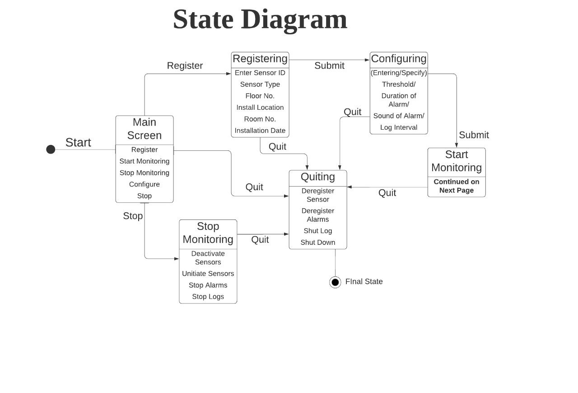
State Diagram

Slide 4
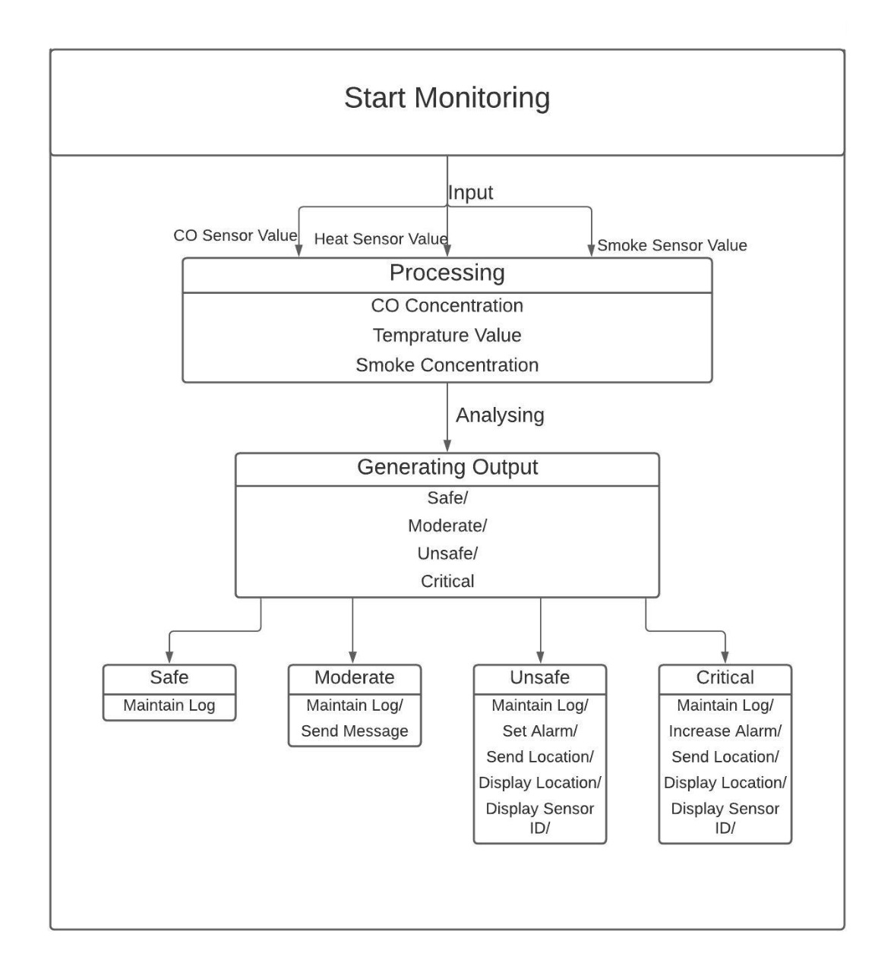
State Diagram Continued..

Slide 5
Class Diagram
Class-diagrams shows relationships of different classes with each other. Each class shows its attributes and methods and they are connected to other classes as per their dependency / relationship with each other (e.g. composition, association, aggregation, inheritance etc.)
It is attained with the help of standard symbols which is shown in the next slide.

Slide 6
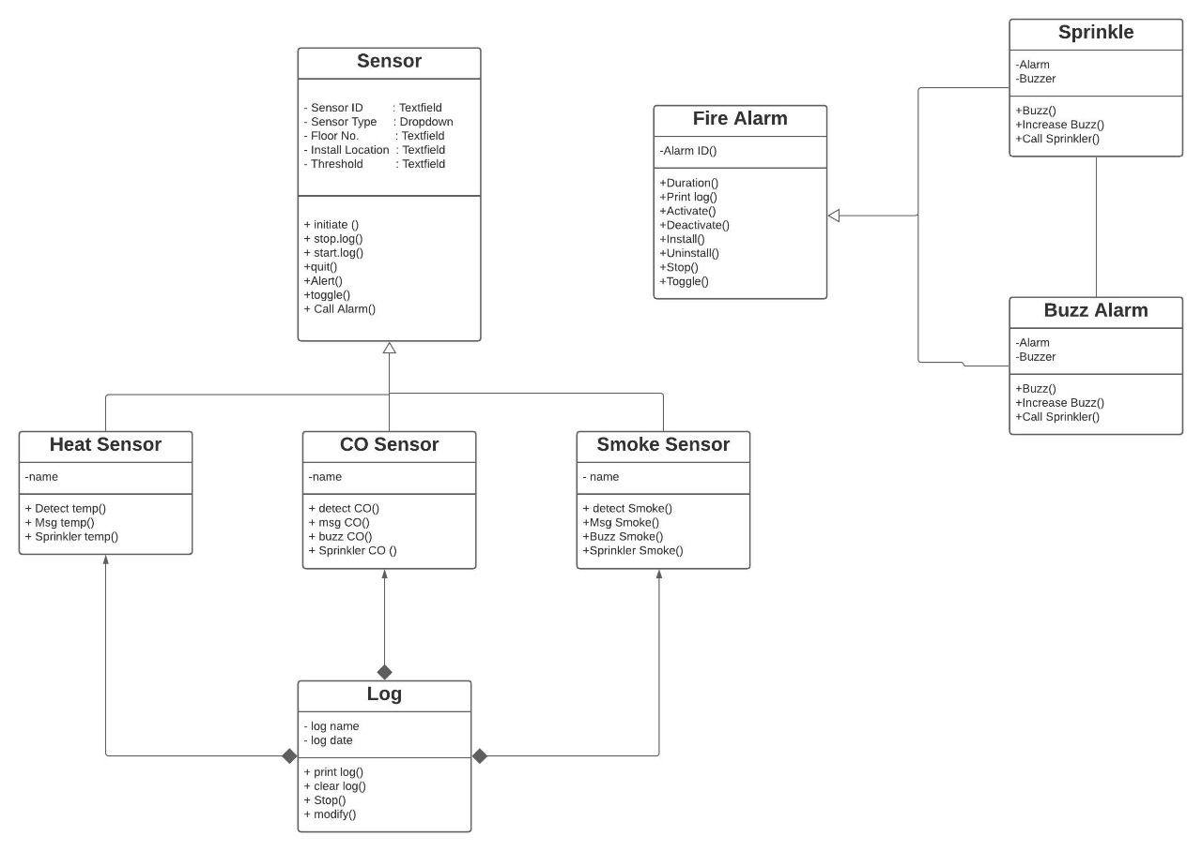
Class Diagram

Slide 7
Our Idea Behind Fire-Alarm System
Here, you can see the basic implementation of the fire-alarm system. i.e. how are you going to link our classes and what all methods we’ll be implementing to access our alarm.
For eg. there’ll be one method which will define which state we’re in after processing the inputs by the sensors. If temperature is greater than 80 degrees than our state is critical. Once known, all the functionalities regarding this state will come into play i.e. a display message on screen which will show the location of the sensor because of which alarm buzzed and sprinklers will start functioning along with very high volume alarm In unsafe state (temp > 50 degrees but less than 80) you’ll get alarm buzzed at low volume and display message.

Slide 8
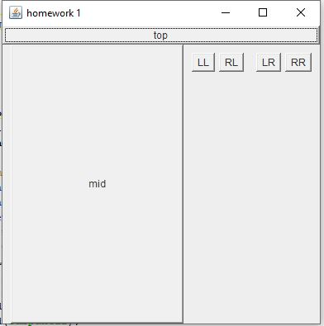
Including GUI
This is a basic GUI application to show how we’ll implement buttons in the interface of our project.
Our main screen will contain 5 buttons ( Register, configure, start monitoring, stop monitoring and quit). They’ll be implemented in the similar fashion.
In the same way text fields and dropdown buttons will be created.
Some of the examples are shown in the next slide.

Slide 9
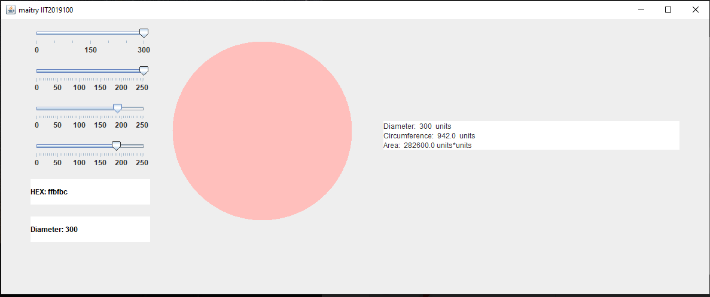
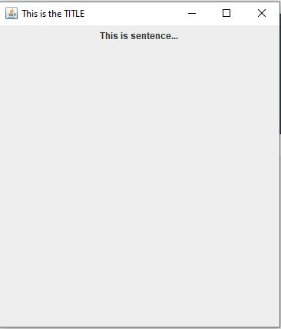
Here you can see the implementation of text fields, sliders, frames, panels etc. Using Swing API we’ll create a screen (i.e. interface b/w user and our system). Which will be followed by using Applet to create a final project.

Slide 10
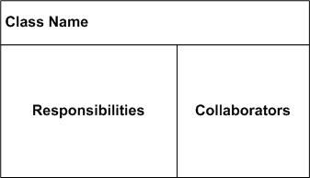
CRC Diagram
A class Responsibility Collaborator diagram is a collection of standard index cards that has been divided into three sections namely:
1)Class Name
2)Responsibilities
3)Collaborators
A class represents a collection of similar objects, a
responsibility is something that a class knows or
does ,and a collaborator is another class that the
class interacts with to fulfil its responsibilities.

Slide 11
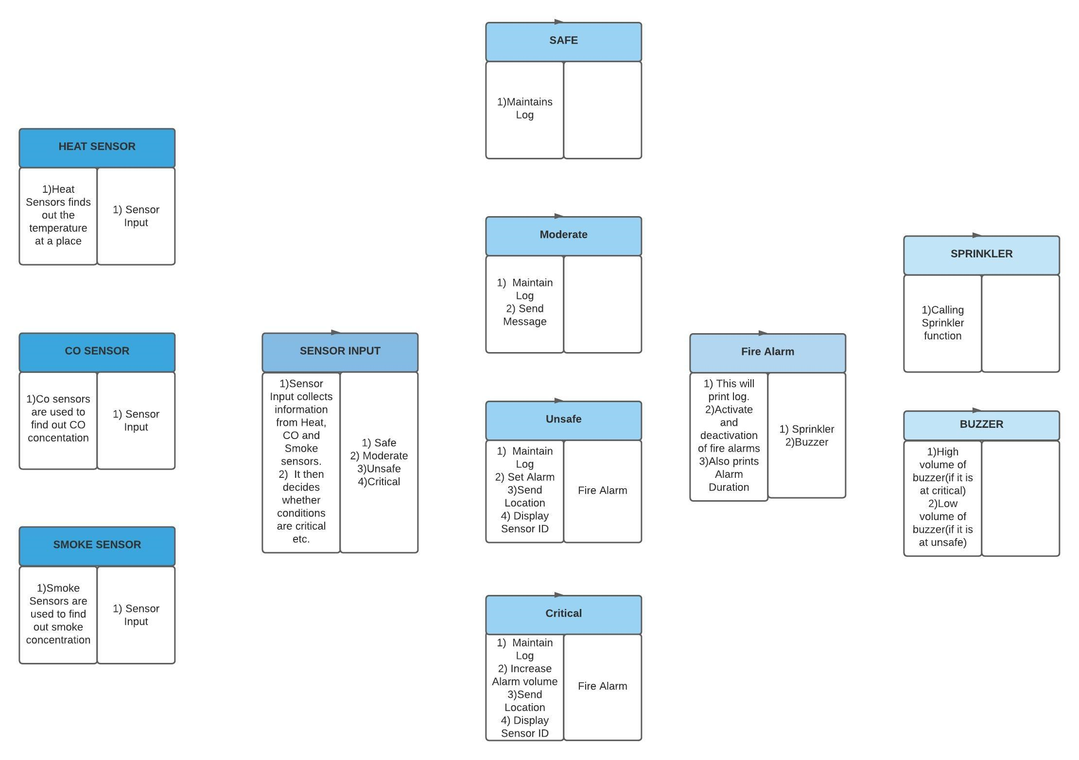
Crc Diagram

Slide 12
Use Case Diagram
Use case diagrams consists of actors, use cases and their relationships within specified system boundaries. These are basically used to model the system/subsystem of an application or a program. It basically shows dynamic behaviour of our system. It shows who and how is he/she using the system and what do they want to achieve or what their target is . It is a useful technique for identifying, clarifying and organizing system requirements. It’s made up of set of all possible sequence of interactions between system and users that define feature the feature to be implemented and resolution of any errors that may be encountered.

Slide 13
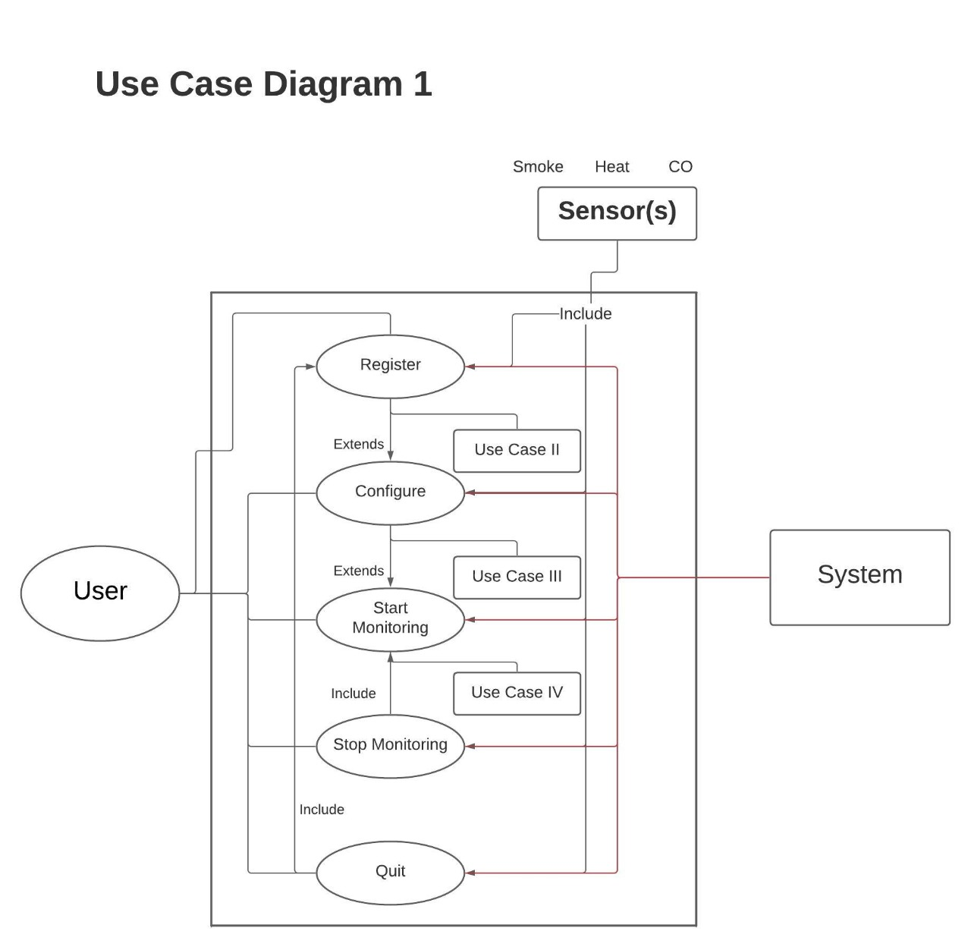
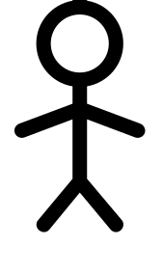
Use Case Diagram

Slide 14
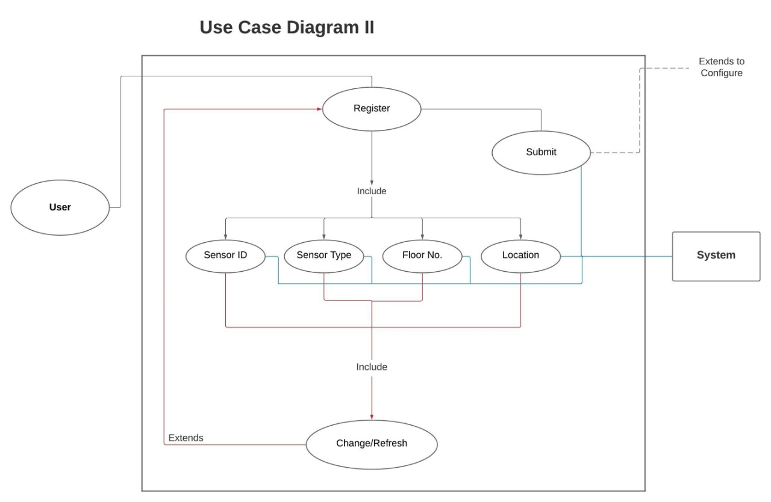
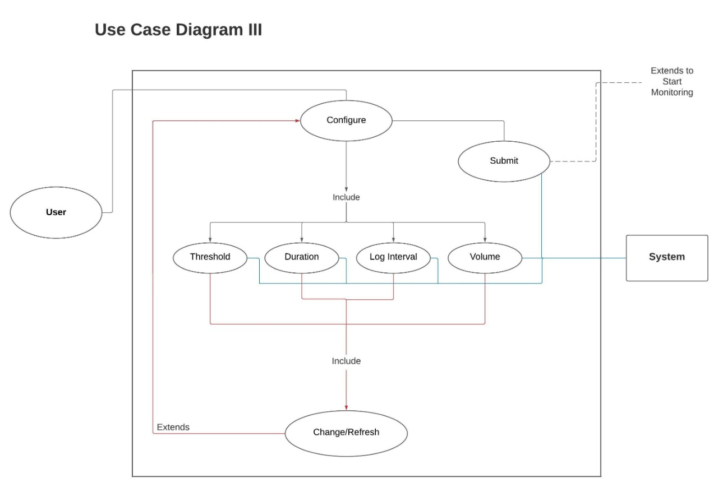
Use Case Diagram

Slide 15
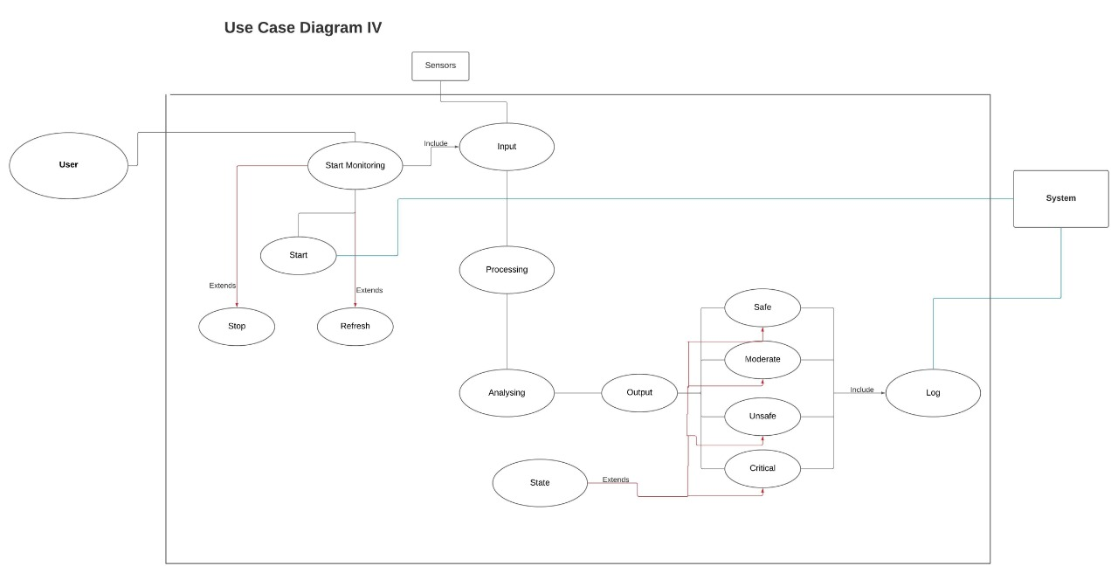
Use Case Diagram

Slide 16
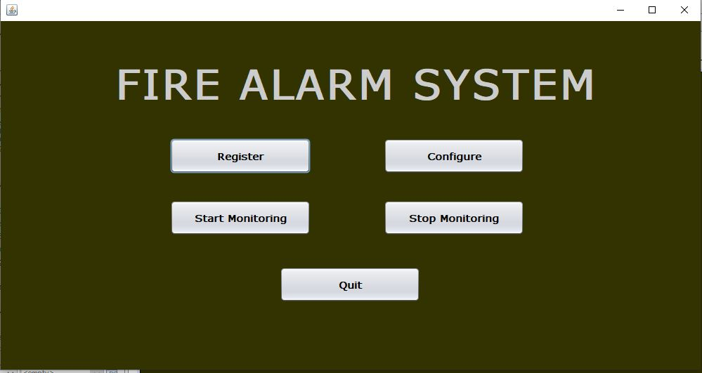

Slide 17
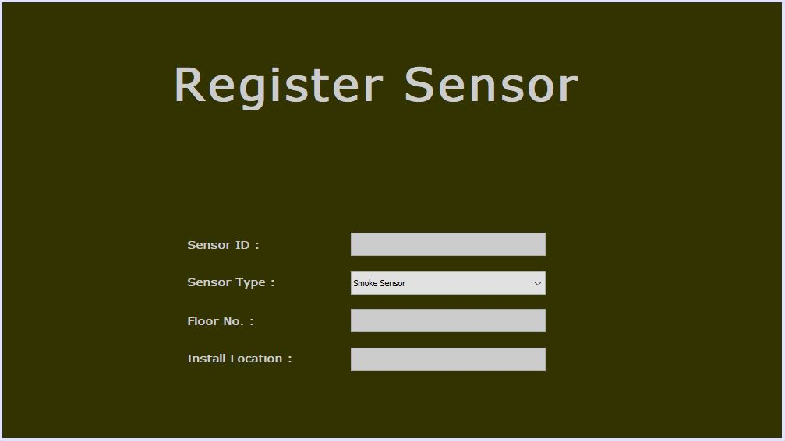

Slide 18
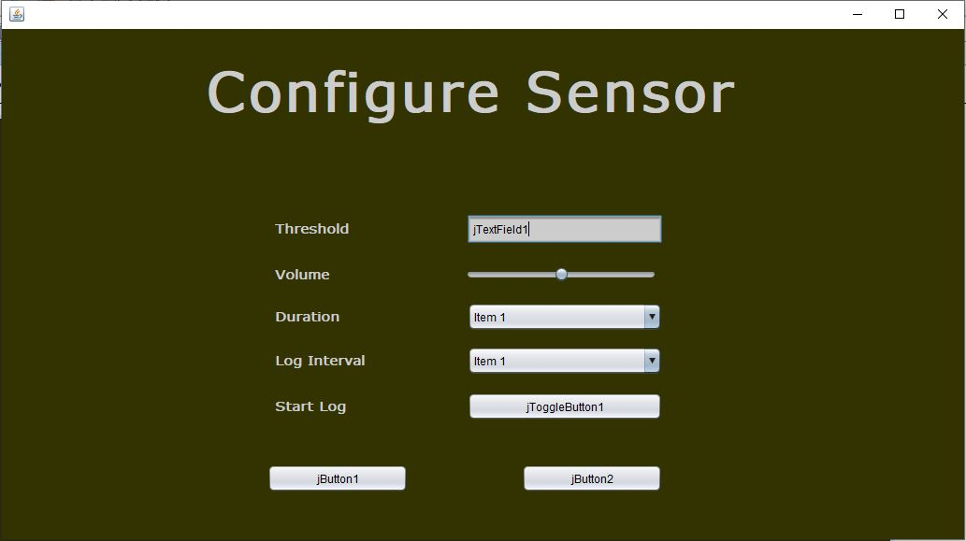

Slide 19
Thank You
Group-8
IIT2019096, IIT2019100, IIT2019122, IIT2019132
Riya Goyal, Maitry Jadiya, Sonal, Dev Bansal

